Slide 1

Oracle Database Architecture
An Oracle server:
  Is a database management system that provides an open, comprehensive, integrated approach to information management
  Consists of an Oracle instance and an Oracle database
Notes:
Oracle Database Architecture
The Oracle server is the key to information management. In general, an Oracle server must reliably manage a large amount of data in a multiuser environment so that many users can concurrently access the same data. All this must be accomplished while delivering high performance. An Oracle server must also prevent unauthorized access and provide efficient solutions for failure recovery.

Slide 2

Database Structures
Memory structures
Instance
System Global Area (SGA)
Process structures
Background processes
Storage structures
Database files
Notes:
Database Structures
Each running Oracle database is associated with an Oracle instance. When a database is started on a database server, the Oracle software allocates a shared memory area called the System Global Area (SGA) and starts several Oracle background processes. This combination of the SGA and the Oracle processes is called an Oracle instance.
After starting an instance, the Oracle software associates the instance with a specific database. This is called mounting the database. The database is then ready to be opened, which makes it accessible to authorized users. Multiple instances can execute concurrently on the same computer, each accessing its own physical database.
You can look at the Oracle database architecture as various interrelated structural components.
An Oracle database uses memory structures and processes to manage and access the database. All memory structures exist in the main memory of the computers that constitute the database server. Processes are jobs that work in the memory of these computers. A process is defined as a “thread of control” or a mechanism in an operating system that can run a series of steps.

Slide 3
Physical Database Structure .
Control files
Data files
Online redo log files
Parameter file
Archive log files
Backup files
Password file
Alert and trace log files
Notes:
Physical Database Structure
The files that constitute an Oracle database are organized into the following:
Control files: Contain data about the database itself (that is, physical database structure information). These files are critical to the database. Without them, you cannot open data files to access the data within the database.
Data files: Contain the user or application data of the database
Online redo log files: Allow for instance recovery of the database. If the database crashes and does not lose any data files, then the instance can recover the database with the information in these files.
The following additional files are important to the successful running of the database:
Parameter file: Is used to define how the instance is configured when it starts up
Password file: Allows users to connect remotely to the database and perform administrative tasks
Backup files: Are used for database recovery. You typically restore a backup file when a media failure or user error has damaged or deleted the original file.
Archive log files: Contain an ongoing history of the data changes (redo) that are generated by the instance. Using these files and a backup of the database, you can recover a lost data file. That is, archive logs enable the recovery of restored data files.

Slide 4
Data Dictionary Views
 | Who Can Query | Contents | Subset of | Notes
DBA_ | DBA | Everything | N/A | May have additional columns meant for DBA use only
ALL_ | Everyone | Everything that the user has privileges to see | DBA_ views | Includes user’s own objects
USER_ | Everyone | Everything that the user owns | ALL_ views | Is usually the same as ALL_ except for the missing OWNER column. Some views have abbreviated names as PUBLIC synonyms.
Notes:
Data Dictionary Views
The view prefixes indicate what or how much data a given user can see. The global view of everything is accessed only by users with DBA privileges, using the DBA_ prefix. The next level of privilege is at the ALL_ prefix level, which represents all objects that the querying user is privileged to see, whether he or she owns them or not. For example, if USER_A has been granted access to a table owned by USER_B, then USER_A sees that table listed in any ALL_ view dealing with table names. The USER_ prefix represents the smallest scope of visibility. This shows only those objects that the querying user owns; that is, those that are present in his or her own schema.

Slide 5
Data Dictionary: Usage Examples
SELECT table_name, tablespace_name FROM user_tables;
a
SELECT sequence_name, min_value, max_value, increment_by FROM all_sequences WHERE sequence_owner IN ('MDSYS','XDB');
b
c
SELECT USERNAME, ACCOUNT_STATUS FROM
dba_users WHERE ACCOUNT_STATUS = 'OPEN';
d
DESCRIBE dba_indexes;
Notes:
Static Data Dictionary: Usage Examples
The examples in the slide show queries that answer these questions:
a. What are the names of the tables (along with the name of the tablespace where they reside) that have been created in your schema?
b. What is the significant information about any sequences in the database that you have access to?
c. What users in this database are currently able to log in?
d. What are the columns of the DBA_INDEXES view? This shows you what information you can view about all the indexes in the database. The following is a partial output of this command:
SQL> DESCRIBE dba_indexes;
Name Null? Type
--------------- -------- -------------
OWNER NOT NULL VARCHAR2(30)
INDEX_NAME NOT NULL VARCHAR2(30)
INDEX_TYPE VARCHAR2(27)
TABLE_OWNER NOT NULL VARCHAR2(30)
TABLE_NAME NOT NULL VARCHAR2(30)

Slide 6
Tablespaces and Data Files
  Tablespaces consist of one or more data files.
  Data files belong to only one tablespace.
Data file 1
Data file 2
USERS tablespace
Notes:
Tablespaces and Data Files
A database is divided into logical storage units called tablespaces, which can be used to group related logical structures together. Each database is logically divided into one or more tablespaces. One or more data files are explicitly created for each tablespace to physically store the data of all logical structures in a tablespace.
Note: You can also create the bigfile tablespaces, which are tablespaces with a single but very large (up to 4 billion data blocks) data file. The traditional smallfile tablespaces (which are the default) can contain multiple data files, but the files cannot be as large. For more information about the bigfile tablespaces, see the Database Administrator’s Guide.

Slide 7
SYSTEM and SYSAUX Tablespaces
  The SYSTEM and SYSAUX tablespaces are mandatory tablespaces.
  They are created at the time of database creation.
  They must be online.
  The SYSTEM tablespace is used for core functionality (for example, data dictionary tables).
  The auxiliary SYSAUX tablespace is used for additional database components (such as the Enterprise Manager Repository).
Notes:
SYSTEM and SYSAUX Tablespaces
Each Oracle database contains a SYSTEM tablespace and a SYSAUX tablespace. They are automatically created when the database is created. The system default is to create a smallfile tablespace. You can also create bigfile tablespaces, which enable the Oracle database to manage ultralarge files (up to 8 exabytes).
A tablespace can be online (accessible) or offline (not accessible). The SYSTEM tablespace is always online when the database is open. It stores tables that support the core functionality of the database, such as the data dictionary tables.
The SYSAUX tablespace is an auxiliary tablespace to the SYSTEM tablespace. The SYSAUX tablespace stores many database components, and it must be online for the correct functioning of all database components.

Slide 8
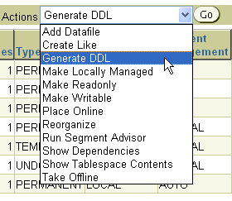
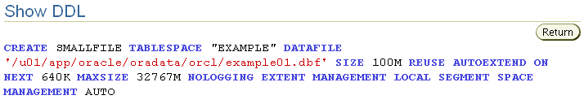
Actions with Tablespaces
Notes:
Actions with Tablespaces
Using the Actions menu, you can perform a variety of tasks with your tablespaces. Select a tablespace and then the action that you want to perform:
Add Datafile: Adds a data file to the tablespace, which makes the tablespace larger
Create Like: Creates another tablespace by using the tablespace as a template
Generate DDL: Generates the data definition language (DDL) statement that creates the tablespace. This can then be copied and pasted into a text file for use as a script or for documentation purposes.
Make Locally Managed: Converts the tablespace to locally managed if the tablespace is currently dictionary managed. This conversion is only one way; you cannot convert the tablespace back to dictionary managed.
Make Readonly: Stops all writes to the tablespace. Current transactions are allowed to complete, but no new DML or other write activities are allowed to start on the tablespace. This appears only if the tablespace is currently not read-only.
Make Writable: Allows DML and other write activities to be initiated on objects in the tablespace. This appears only if the tablespace is currently not writable.

Slide 9
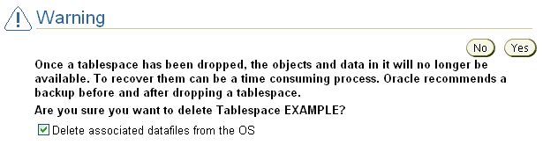
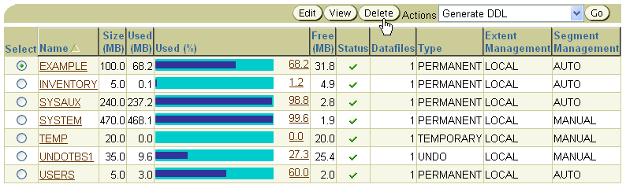
Dropping Tablespaces
Notes:
Dropping Tablespaces
You can drop a tablespace and its contents (the segments contained in the tablespace) from the database if the tablespace and its contents are no longer required. You must have the DROP TABLESPACE system privilege to drop a tablespace.
When you drop a tablespace, the file pointers in the control file of the associated database are removed. You can optionally direct the Oracle server to delete the operating system files (data files) that constitute the dropped tablespace. If you do not direct the Oracle server to delete the data files at the same time as it deletes the tablespace, you must later use the appropriate commands of your operating system if you want them to be deleted.
You cannot drop a tablespace that contains any active segments. For example, if a table in the tablespace is currently being used or the tablespace contains undo data that is needed to roll back uncommitted transactions, you cannot drop the tablespace. The tablespace can be online or offline, but it is best to take the tablespace offline before dropping it.

Slide 10

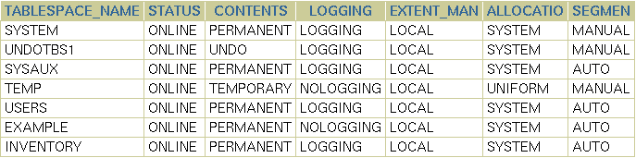
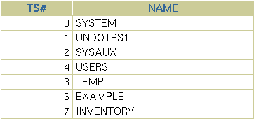
Viewing Tablespace Information
Notes:
Viewing Tablespace Information
Click View to see information about the selected tablespace. On the View Tablespace page, you can also click Edit to alter the tablespace.
Tablespace and data file information can also be obtained by querying the following:
Tablespace information:
DBA_TABLESPACES
V$TABLESPACE
Data file information:
DBA_DATA_FILES
V$DATAFILE
Temp file information:
DBA_TEMP_FILES
V$TEMPFILE

Slide 11




Segments, Extents, and Blocks
  Segments exist within a tablespace.
  Segments are made up of a collection of extents.
  Extents are a collection of data blocks.
  Data blocks are mapped to disk blocks.
Segment
Extents
Data blocks
Disk blocks
Notes:
Segments, Extents, and Blocks
Database objects, such as tables and indexes, are stored as segments in tablespaces. Each segment contains one or more extents. An extent consists of contiguous data blocks, which means that each extent can exist only in one data file. Data blocks are the smallest unit of I/O in the database.
When the database requests a set of data blocks from the operating system (OS), the OS maps this to an actual file system or disk block on the storage device. Because of this, you need not know the physical address of any of the data in your database. This also means that a data file can be striped or mirrored on several disks.
The size of the data block can be set at the time of the creation of the database. The default size of 8 KB is adequate for most databases. If your database supports a data warehouse application that has large tables and indexes, then a larger block size may be beneficial.
If your database supports a transactional application where reads and writes are random, then specifying a smaller block size may be beneficial. The maximum block size depends on your OS. The minimum Oracle block size is 2 KB and should rarely (if ever) be used.
You can have tablespaces with different block sizes. However, this should be used only for transportable tablespaces. For details, see the Database Administrator’s Guide.

Slide 12
Logical and Physical Database Structures
Logical
Physical
Database
Schema
Tablespace
Data file
Segment
Extent
Oracle data
block
OS block
Notes:
Logical and Physical Database Structures
An Oracle database is a collection of data that is treated as a unit. The general purpose of a database is to store and retrieve related information. The database has logical structures and physical structures.
Tablespaces
A database is divided into logical storage units called tablespaces, which group related logical structures together. For example, tablespaces commonly group all of an application’s objects to simplify some administrative operations. You may have a tablespace for application data and an additional one for application indexes.
Databases, Tablespaces, and Data Files
The relationship among databases, tablespaces, and data files is illustrated in the slide. Each database is logically divided into one or more tablespaces. One or more data files are explicitly created for each tablespace to physically store the data of all logical structures in a tablespace. If it is a TEMPORARY tablespace, instead of a data file, then the tablespace has a temporary file.

Slide 13
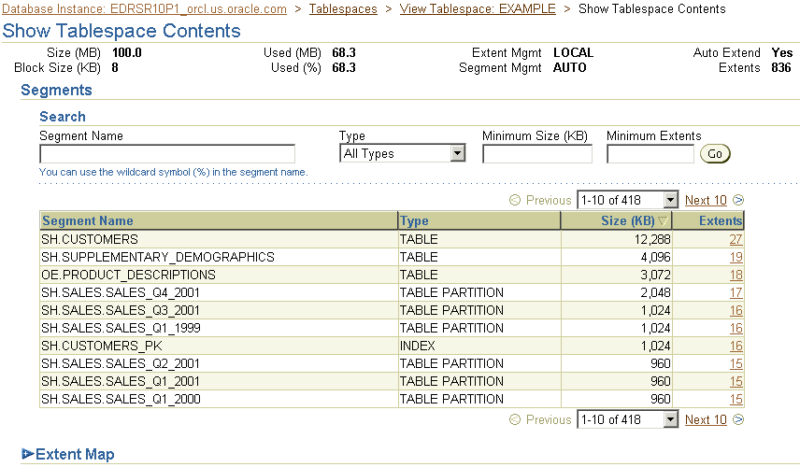
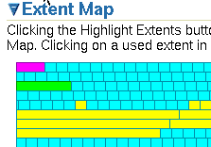

Viewing Tablespace Contents
12061_1_sel_ts_3
Notes:
Viewing Tablespace Contents
On the Show Tablespace Contents page, detailed information about the tablespace is displayed, including a list of the segments in the tablespace, the type of each segment, the segment size, and the number of extents that comprise each segment. Any of these four values can be used to sort the list by clicking the column header, or to filter the list by entering values in the Search region. For a dictionary-managed tablespace, additional columns are displayed:
Max Extents
Next
Percent Increase
To see a list of extents, click the link in the Extents column.
To view extents in a graphical way, expand the “Extent map” and move the cursor over individual extents. The following information is displayed:
Name of the segment the extent belongs to
Extent ID
Block ID
Extent size in blocks
Data file in which the extent is stored

Slide 14
How Table Data Is Stored
Columns
Blocks
Table A
Table B
Rows
Segment
Segment
Table
Tablespace
Row piece
Extent
Notes:
How Table Data Is Stored
When a table is created, a segment is created to hold its data. A tablespace contains a collection of segments. Logically, a table contains rows of column values. A row is ultimately stored in a database block in the form of a row piece. It is called a row piece because under some circumstances the entire row may not be stored in one place. This happens when an inserted row is too large to fit into a single block or when an update causes an existing row to outgrow its current space.

Slide 15
Anatomy of a Database Block
Block header
Growth
Free space
Row data
Notes:
Database Block: Contents
Oracle data blocks contain the following:
Block header: The block header contains the segment type (such as table or index), data block address, table directory, row directory, and transaction slots of size 23 bytes each, which are used when modifications are made to rows in the block. The block header grows downward from the top.
Row data: This is the actual data for the rows in the block. Row data space grows upward from the bottom.
Free space: Free space is in the middle of the block. This enables the header and the row data space to grow when necessary. Row data takes up free space as new rows are inserted or columns of existing rows are updated with larger values. The examples of events that cause header growth are when the row directory needs more row entries or more transaction slots are required than initially configured. Initially, the free space in a block is contiguous. However, deletions and updates may fragment the free space in the block. The free space in the block is coalesced by the Oracle server when necessary.

Slide 16
Tablespaces and Data Files
The Oracle database stores data logically in tablespaces and physically in data files.
  Tablespaces:
    Can belong to only one database
    Consist of one or more data files
    Are further divided into logical units of storage
  Data files:
    Can belong to only one
    tablespace and one database
    Are a repository for schema
    object data
Database
Tablespace
Data files
Notes:
Tablespaces and Data Files
Databases, tablespaces, and data files are closely related but they have important differences:
An Oracle database consists of one or more logical storage units called tablespaces, which collectively store all the database’s data.
Each tablespace in an Oracle database consists of one or more files called data files, which are physical structures that conform to the operating system on which the Oracle software runs.
A database’s data is collectively stored in the data files that constitute each tablespace of the database. For example, the simplest Oracle database would have two tablespaces (the required SYSTEM and SYSAUX tablespaces), each with one data file. Another database can have three tablespaces, each consisting of two data files (for a total of six data files). A single database can potentially have as many as 65,534 data files.

Slide 17

Space Management in Tablespaces
  Locally managed tablespace:
    Free extents are managed in the tablespace.
    A bitmap is used to record free extents.
    Each bit corresponds to a block or group of blocks.
    The bit value indicates free or used extents.
    The use of locally managed tablespaces is recommended.
  Dictionary-managed tablespace:
    Free extents are managed by the data dictionary.
    Appropriate tables are updated when extents are allocated or unallocated.
    These tablespaces are supported only for backward compatibility.
Notes:
Space Management in Tablespaces
Tablespaces allocate space in extents. Tablespaces can be created to use one of the following two methods of keeping track of free and used space:
Locally managed tablespaces: The extents are managed within the tablespace via bitmaps. Each bit in the bitmap corresponds to a block or a group of blocks. When an extent is allocated or freed for reuse, the Oracle server changes the bitmap values to show the new status of the blocks.
Dictionary-managed tablespaces: The extents are managed by the data dictionary. The Oracle server updates the appropriate tables in the data dictionary whenever an extent is allocated or unallocated. This is for backward compatibility; it is recommended that you use locally managed tablespaces.

Slide 18
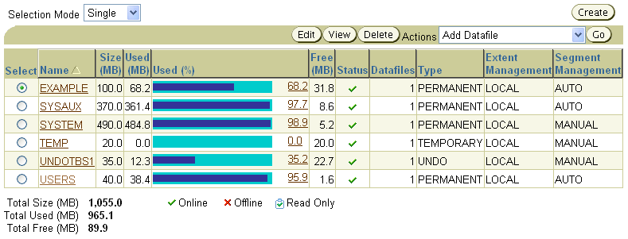
Tablespaces in the Preconfigured Database
  SYSTEM
  SYSAUX
  TEMP
  UNDOTBS1
  USERS
  EXAMPLE
Notes:
Tablespaces in the Preconfigured Database
The following tablespaces are created in the preconfigured database in this course:
SYSTEM: The SYSTEM tablespace is used by the Oracle server to manage the database. It contains the data dictionary and tables that contain administrative information about the database. These are all contained in the SYS schema and can be accessed only by the SYS user or other administrative users with the required privilege.
SYSAUX: This is an auxiliary tablespace to the SYSTEM tablespace. Some components and products that used the SYSTEM tablespace or their own tablespaces in earlier releases of the Oracle database, now use the SYSAUX tablespace. Every Oracle Database10g or later release must have a SYSAUX tablespace.
In Enterprise Manager, you can see a pie chart of the contents of this tablespace. To do this, click Tablespaces on the Administration page. Select SYSAUX and click Edit. Then, click the Occupants tab. After creation, you can monitor the space usage of each occupant inside the SYSAUX tablespace by using EM. If you detect that a component is taking too much space in the SYSAUX tablespace, or if you anticipate that it will, you can move the occupant into a different tablespace by selecting one of the occupants and clicking Change Tablespace.

Slide 19

Enlarging the Database
  You can enlarge the database in the following ways:
    Creating a new tablespace
    Adding a data file to an existing tablespace
    Increasing the size of a data file
    Providing for the dynamic growth of a data file
Database
SYSTEM
tablespace
INVENTORY
tablespace
Notes:
Enlarging the Database
These activities can be performed with Enterprise Manager or with SQL statements. In the end, the size of the database can be described as the sum of all of its tablespaces.

Slide 20



What Is a Schema?
owns
HR schema
HR user
Notes:
What Is a Schema?
A schema is a collection of database objects that are owned by a particular user. Typically, for a production database, this user does not represent a person, but an application. A schema has the same name as the user that owns the schema. Schema objects are the logical structures that directly refer to database’s data. Schema objects include structures such as tables, views, and indexes.
You can create and manipulate schema objects by using SQL or Enterprise Manager. When you use Enterprise Manager, the underlying SQL is generated for you.
Note: A schema does not necessarily have to be directly related to a single tablespace. You can define configurations such that objects in a single schema can be in different tablespaces, and a tablespace can hold objects from different schemas.

Slide 21

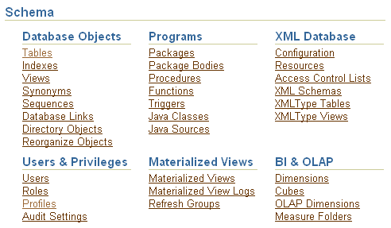
Accessing Schema Objects
Notes:
Accessing Schema Objects
You can quickly access many types of schema objects from the Schema region of the Database Administration page.
After clicking one of the links, the Results page is displayed. In the Search region of the page, you can enter a schema name and object name to search for a specific object. In addition, you can search for other types of objects from the Search region by selecting the object type from the drop-down list. The drop-down list includes additional object types that are not shown as links on the Database Administration page.

Slide 22






Specifying Data Types in Tables
Common data types:
  CHAR(size [BYTE|CHAR]): Fixed-length character data of size bytes or characters
  VARCHAR2(size [BYTE|CHAR]): Variable-length character string having a maximum length of size bytes or characters
  DATE: Valid date ranging from January 1, 4712 B.C. through A.D. December 31, 9999
  NUMBER(p,s): Number with precision p and
  scale s
Notes:
Specifying Data Types in Tables
When you create a table, you must specify a data type for each of its columns. When you create a procedure or function, you must specify a data type for each of its arguments. These data types define the domain of values that each column can contain or each argument can have.
Built-in data types in the Oracle database include the following:
CHAR: Fixed-length character data of size bytes or characters. The maximum size is 2,000 bytes or characters; the default and minimum size is 1 byte.
BYTE indicates that the column has byte length semantics.
CHAR indicates that the column has character semantics.
VARCHAR2: Variable-length character string having maximum length size bytes or characters. The maximum size is 4,000 bytes. You must specify the size for VARCHAR2.
DATE: Valid date ranging from January 1, 4712 B.C. through A.D. December 31, 9999. It also stores the time: hours, minutes, and seconds.
NUMBER: Number with precision p and scale s. The precision can range from 1 through 38. The scale can range from –84 through 127.

Slide 23
Specifying Data Types in Tables
Full Notes Page
Notes:
Specifying Data Types in Tables (continued)
BINARY_FLOAT: This is a 32-bit floating-point number. This data type requires 5 bytes, including the length byte.
BINARY_DOUBLE: This is a 64-bit floating-point number. This data type requires 9 bytes.
FLOAT(p): This is an American National Standards Institute (ANSI) data type. The FLOAT data type is a floating-point number with a binary precision p. The default precision for this data type is 126 binary or 38 decimal.
INTEGER: This is equivalent to NUMBER(p,0).
NCHAR(length): The NCHAR data type is a Unicode-only data type. When you create a table with an NCHAR column, you define the column length in characters. You define the national character set when you create your database. The maximum length of a column is determined by the national character set definition. The width specifications of the NCHAR data type refer to the number of characters. The maximum column size allowed is 2,000 bytes. If you insert a value that is less than the column length, the Oracle database pads the value with blanks for full column length. You cannot insert a CHAR value into an NCHAR column, nor can you insert an NCHAR value into a CHAR column.
NVARCHAR2(size [BYTE|CHAR]): The NVARCHAR2 data type is a Unicode-only data type. It is like NCHAR except that its maximum length is 4,000 bytes and it is not blank-padded.
LONG: This is a character data of variable length of up to 2 gigabytes or 2³¹ –1 bytes. The LONG data type is deprecated; use the large object (LOB) data type instead.
LONG RAW: This is raw binary data of variable length of up to 2 gigabytes.
RAW(size): This is raw binary data of length size bytes. The maximum size is 2,000 bytes. You must specify the size for a RAW value.
ROWID: This is a base 64 string representing the unique address of a row in its table. This data type is primarily for values returned by the ROWID pseudocolumn.
UROWID: This is a base 64 string representing the logical address of a row of an index-organized table. The optional size is the size of a column of the UROWID type. The maximum size and default is 4,000 bytes.
BLOB: This is a binary large object.
CLOB: This is a character large object containing single-byte or multibyte characters. Both fixed-width and variable-width character sets are supported, and both use the CHAR database character set.

Slide 24
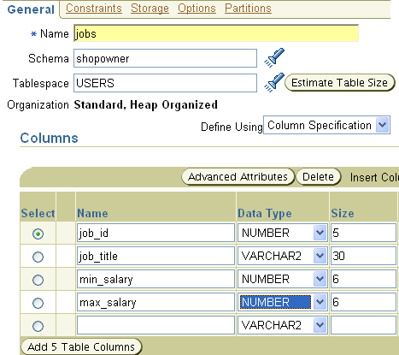
Creating and Modifying Tables
Specify the table name and schema.
Specify the column names, data types, and lengths.
Notes:
Creating and Modifying Tables
Tables are the basic units of data storage in an Oracle database. They hold all user-accessible data. Each table has columns and rows.
Creating a Table
To create a table by using Enterprise Manager, perform the following steps:
1. Click Tables in the Schema region of the Administration page. The Tables page appears.
2. If you know the schema name, enter all or part of it in the Schema field in the Search region. If you do not know the schema name, click the flashlight icon next to the Schema field. The Search and Select: Schema window appears. You can browse through the schema names and select the one that you are looking for.
3. Click Create. The Create Table: Table Organization page appears.
4. Accept the default of Standard, Heap Organized by clicking Continue. The Create Table page appears.
5. Enter the table name in the Name field.
6. Enter the schema name in the Schema field, or click the flashlight icon to invoke the search function.

Slide 25

Sequences
A sequence is a mechanism for automatically generating integers that follow a pattern.
  A sequence has a name, which is
  how it is referenced when the next
  value is requested.
  A sequence is not associated with
  any particular table or column.
  The progression can be ascending or
  descending.
  The interval between numbers can be of any size.
  A sequence can cycle when a limit is reached.
1
2
3
4
5
Notes:
Sequences
To retrieve the next value from a sequence, you reference it by its name; there is no association of a sequence to a table or a column.
After a given number is issued, it will not be issued again, unless the sequence is defined as cyclical. Sometimes an application requests a value it never ends up using or storing in the database. This may result in gaps in the numbers that reside in the table that they are being stored into.
Caching of sequence numbers improves performance because a set of numbers is preallocated in memory for faster access. If there is an instance failure, any cached sequence numbers are not used, which results in gaps.
Note: If an application requires that there be no gaps, then the application should implement a custom number generator. However, this method can result in very poor performance. If you use a table to store a value, and increment that value and update the table for each request, that process would be a systemwide bottleneck. This is because every session would have to wait for that mechanism, which, to guarantee no duplicates or gaps, can handle only a single request at a time.

Slide 26
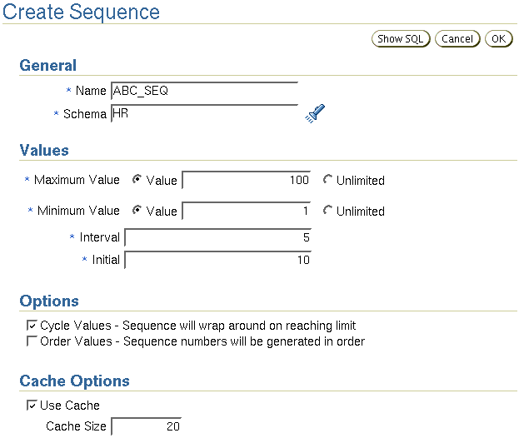

Creating a Sequence
Notes:
Creating a Sequence
You can view and create sequences with Enterprise Manager by clicking the Sequences link under the Schema heading of the Administration page. Here is a summary of the sequence creation options:
Name: This is the name of the sequence, which is how it is referenced.
Schema: This is the owner of the sequence.
Maximum Value: Specify the maximum value that the sequence can generate. This integer value can have 28 or fewer digits. It must be greater than Minimum Value and Initial. Using Unlimited indicates the maximum value of 10²⁷ for an ascending sequence or –1 for a descending sequence. The default is Unlimited.
Minimum Value: Specify the minimum value of the sequence. This integer value can have 28 or fewer digits. It must be less than or equal to Initial and less than Maximum Value. Using Unlimited indicates the minimum value of 1 for an ascending sequence or –10²⁶ for a descending sequence. The default is Unlimited.

Slide 27
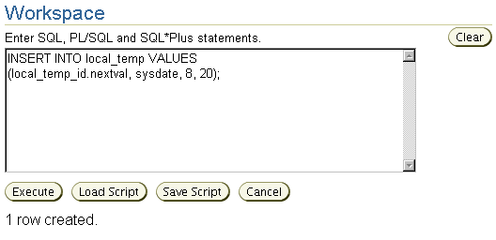
Using a Sequence
Notes:
Using a Sequence
Refer to sequence values in SQL statements with the following pseudocolumns:
CURRVAL: Returns the current value of a sequence
NEXTVAL: Increments the sequence and returns the next value
You must qualify CURRVAL and NEXTVAL with the name of the sequence:
sequence.CURRVAL
sequence.NEXTVAL
The first reference to NEXTVAL returns the initial value of the sequence. Subsequent references to NEXTVAL increment the sequence value by the defined increment and return the new value. Any reference to CURRVAL always returns the current value of the sequence, which is the value returned by the last reference to NEXTVAL.

